Slide 1



MOVIE TICKET BOOKING

Slide 2
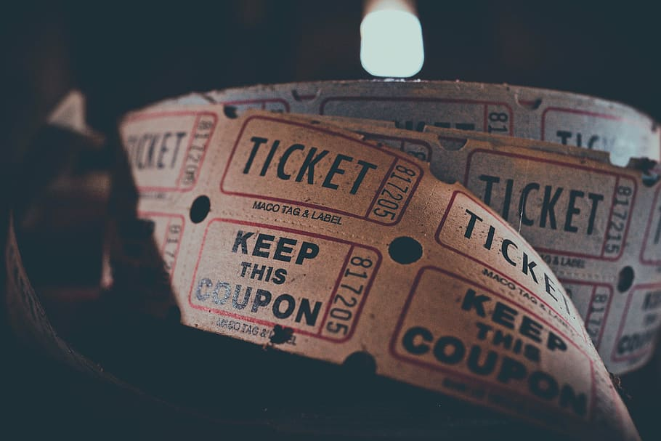
INDEX
Abstract
Modules of our Project
Code of our Project
Outputs of our Project
Conclusion

Slide 3

ABSTRACT
Our Project is Movie ticket booking. In this project you can book the tickets for any movie and you can also delete the ticket. To Book the ticket just you have to enter how many tickets you need and which movie then the ticket is ready according to the given price.

Slide 4
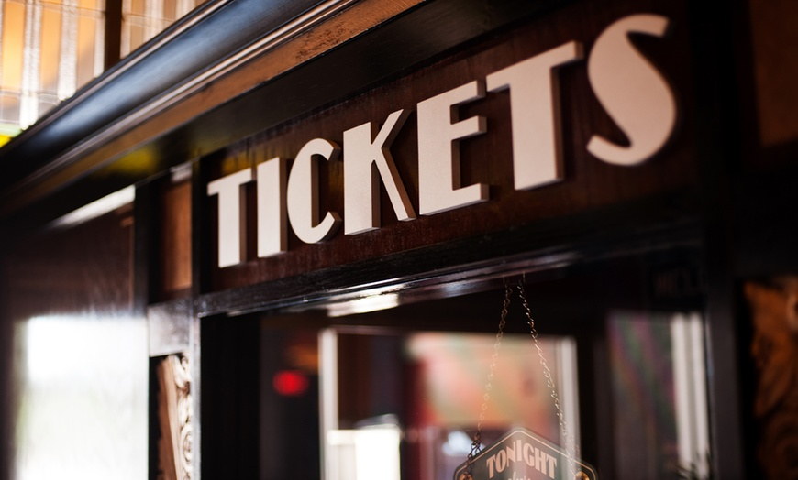
Modules of our Project

Slide 5
MODULES OF OUR PROJECT
1. Inserting or Creating the ticket
For our project the first module is Inserting the ticket. To Insert the Ticket, first a menu option is given whether you want to insert or add the ticket, delete the ticket or display the ticket.
To insert the ticket according to our code you have to enter the ‘1’ option. Then it will ask you which movie are you willing to go. Similarly we gave some movie names and options. It will ask in the same way. For Example if you enter ‘2’ option then according to what movie we have given the movie name is entered. Now it will ask how many tickets do you want then enter the number of tickets and it will ask to book the seats. Now according to our code the price of an each ticket is going to multiply to your number of tickets. Then the ticket is going to display.

Slide 6
2. Deleting the ticket
For our project the second module is deleting the ticket. To delete the ticket according to our code you have to enter the ‘2’ option but before deleting any ticket, first the ticket should be created or added. If not it will give a message that no bookings are found to delete. So when we insert the tickets each ticket is given with an I’d number. So after pressing the option ‘2’ for deletion then it will ask to enter the ticket I’d number So that according to the I’d number the ticket is going to delete. Then once the ticket is deleted then it gives a message that the ticket is deleted.

Slide 7

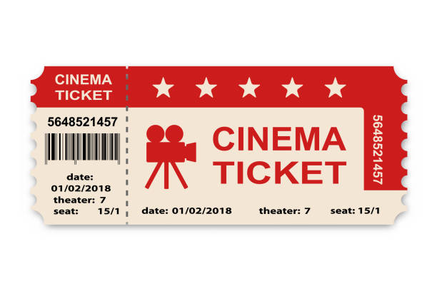
3. Displaying the ticket
For our project the third module is displaying the ticket. To display the ticket according to our code you have to enter the ‘3’ option but before displaying check whether you have inserted the tickets or not. If not it gives a message that no bookings are found. So when you click the option ‘3’ then all the inserted tickets are going to display with I’d, movie name, screen, time, date, number of tickets and price.
4.To Exit from the program
For our project the fourth module is to exit from the program. To exit from the program according to our code you have to enter the ‘4’ option then it will give a message that the program is going to stop and it will be end the program.

Slide 8

CODE OF OUR PROJECT

Slide 9
Code of our Project
MENU OPTION
printf("\n|-------------------------------------------------------------|");
printf("\n| MAIN MENU |");
printf("\n|-------------------------------------------------------------|");
printf("\n| ENTER 1 TO SELECT A MOVIE |");
printf("\n| ENTER 2 TO DELETE TICKET |");
printf("\n| ENTER 3 TO DISPLAY TICKET |");
printf("\n| ENTER 4TO EXIT FROM THE PROGRAM |");
printf("\n|-------------------------------------------------------------|\n");

Slide 10
MENU OPTION FOR MOVIE
printf("\n|------------------------------------------------------------|");
printf("\n| MOVIE NAMES |");
printf("\n|------------------------------------------------------------|");
printf("\n| ENTER 1 FOR INTERSTERLLAR |");
printf("\n| ENTER 2 FOR SITA RAMAM |");
printf("\n| ENTER 3 FOR ORI DEVUDA |");
printf("\n| ENTER 4 FOR HARRY POTTER |");
printf("\n|------------------------------------------------------------|");

Slide 11
Code for Inserting or Creating the ticket
void reservation(int choice,int *id)
{
int i,seats;
struct movie *tp;
tp=(struct movie *)malloc(sizeof(struct movie));
if(tp==NULL)
{
printf("\n...Seats are FULL...\n");
return;
}
int cnt=-1;

Slide 12
if(head==NULL)
{
printf("\nEnter your name:");
gets(tp->person_name);
gets(tp->person_name);
printf("\nEnter no of tickets:");
scanf("%d",&tp->n_viewer);
printf("\nEnter movie name :");
gets(tp->movie_name);
gets(tp->movie_name);
tp->id=*id;
*id=*id+1;
printf("\n-------------------------------------------------------------------------------------------------------------------------------------------------------------------------------------------------------------------\n");
printf(" SELECT SEAT ");
printf("\n-------------------------------------------------------------------------------------------------------------------------------------------------------------------------------------------------------------------\n");

Slide 13
printf("\n\n\t\t\t\t----------------------------------------------------------------------SCREEN------------------------------------------------------\n\n");
for(i=1;i<=100;i++)
{
if(cnt==-1)
{
printf("\t\t\t\t\t");
cnt=0;
}
if(cnt==20)
{
printf("\n\n");
cnt=0;
printf("\t\t\t\t\t");
}

Slide 14
printf("%4d",i);
cnt++;
}
printf("\nEnter your seat numbers:");
for(i=0;i<tp->n_viewer;i++)
{
scanf("%d",&tp->movie_seats[i]);
}
tp->next=NULL;
head=tp;
}
else
{

Slide 15
printf("\nEnter your Name:");
gets(tp->person_name);
gets(tp->person_name);
printf("\nEnter no of tickets:");
scanf("%d",&tp->n_viewer);
printf("\nEnter movie name :");
gets(tp->movie_name);
gets(tp->movie_name);
tp->id=*id;
*id=*id+1;
printf("\n-------------------------------------------------------------------------------------------------------------------------------------------------------------------------------------------------------------------\n");
printf(" SELECT SEAT ");
printf("\n-------------------------------------------------------------------------------------------------------------------------------------------------------------------------------------------------------------------\n");

Slide 16
printf("\n\n\t\t\t\t----------------------------------------------------------------------SCREEN------------------------------------------------------\n\n");
for(i=1;i<=100;i++)
{
if(cnt==-1)
{
printf("\t\t\t\t\t");
cnt=0;
}
if(cnt==20)
{
printf("\n\n");
cnt=0;
printf("\t\t\t\t\t");
}
printf("%4d",i);
cnt++;

Slide 17
}
printf("\nEnter your seat numbers:");
for(i=0;i<tp->n_viewer;i++)
{
scanf("%d",&tp->movie_seats[i]);
}
tp->next=head;
head=tp;
}
if(choice==1)
{
bill_movie1();
}
else if(choice==2)

Slide 18
bill_movie2();
}
else if(choice==3)
{
bill_movie3();
}
else
{
bill_movie4();
}
}

Slide 19
Code for Deleting the ticket
void delete_ticket()
{
if(head==NULL)
{
printf("\n...You did not book your ticket...\n");
return;
}
int counting=0,count;
int i_d;
printf("\nEnter your ticket id:");
scanf("%d",&i_d);
struct movie *tp,*pp,*cp;
tp=head;

Slide 20
pp=head;
cp=head;
while(tp->id!=i_d)
{
tp=tp->next;
}
if(head==tp)
{
if(tp->next==NULL)
{
head=NULL;
free(tp);
}
else
{

Slide 21
head=tp->next;
free(tp);
}
}
else
{
if(tp->next==NULL)
{
while(pp->next!=tp)
{
pp=pp->next;
}
pp->next=NULL;
free(tp);
}
else
{

Slide 22
while(pp->next!=tp)
{
pp=pp->next;
}
pp->next=tp->next;
free(tp);
}
}
}

Slide 23
Code for Displaying the ticket
void display_all_ticket()
{
int count=1000,i,amount;
struct movie *tp;
tp=(struct movie *)malloc(sizeof(struct movie));
tp=head;
if(head==NULL)
{
printf("\n...Booking is not found...\n");
return;
}
while(tp!=NULL)
{
printf("\n\n");
printf}

Slide 24
printf("\t-----------------THEATER BOOKING TICKET----------------\n");
printf("\t============================================================\n");
printf("\t Booking ID : %d \t\t\tShow Name : %s \n",tp->id,tp->movie_name);
printf("\t Customer : %s\n",tp->person_name);
printf("\t\t\t Date : 14-11-2022\n");
printf("\t Time : 10:30am\n");
printf("\t Hall : 01\n");
for(i=0;i<tp->n_viewer&&tp!=NULL;i++)
{
printf("\t seats No. : %d \n",tp->movie_seats[i]);
}
amount=(tp->n_viewer*150)+10;
printf("\t price . : %d \n\n",amount);
printf("\t============================================================\n");
tp=tp->next;
}

Slide 25

OUTPUTS OF OUR PROJECT

Slide 26
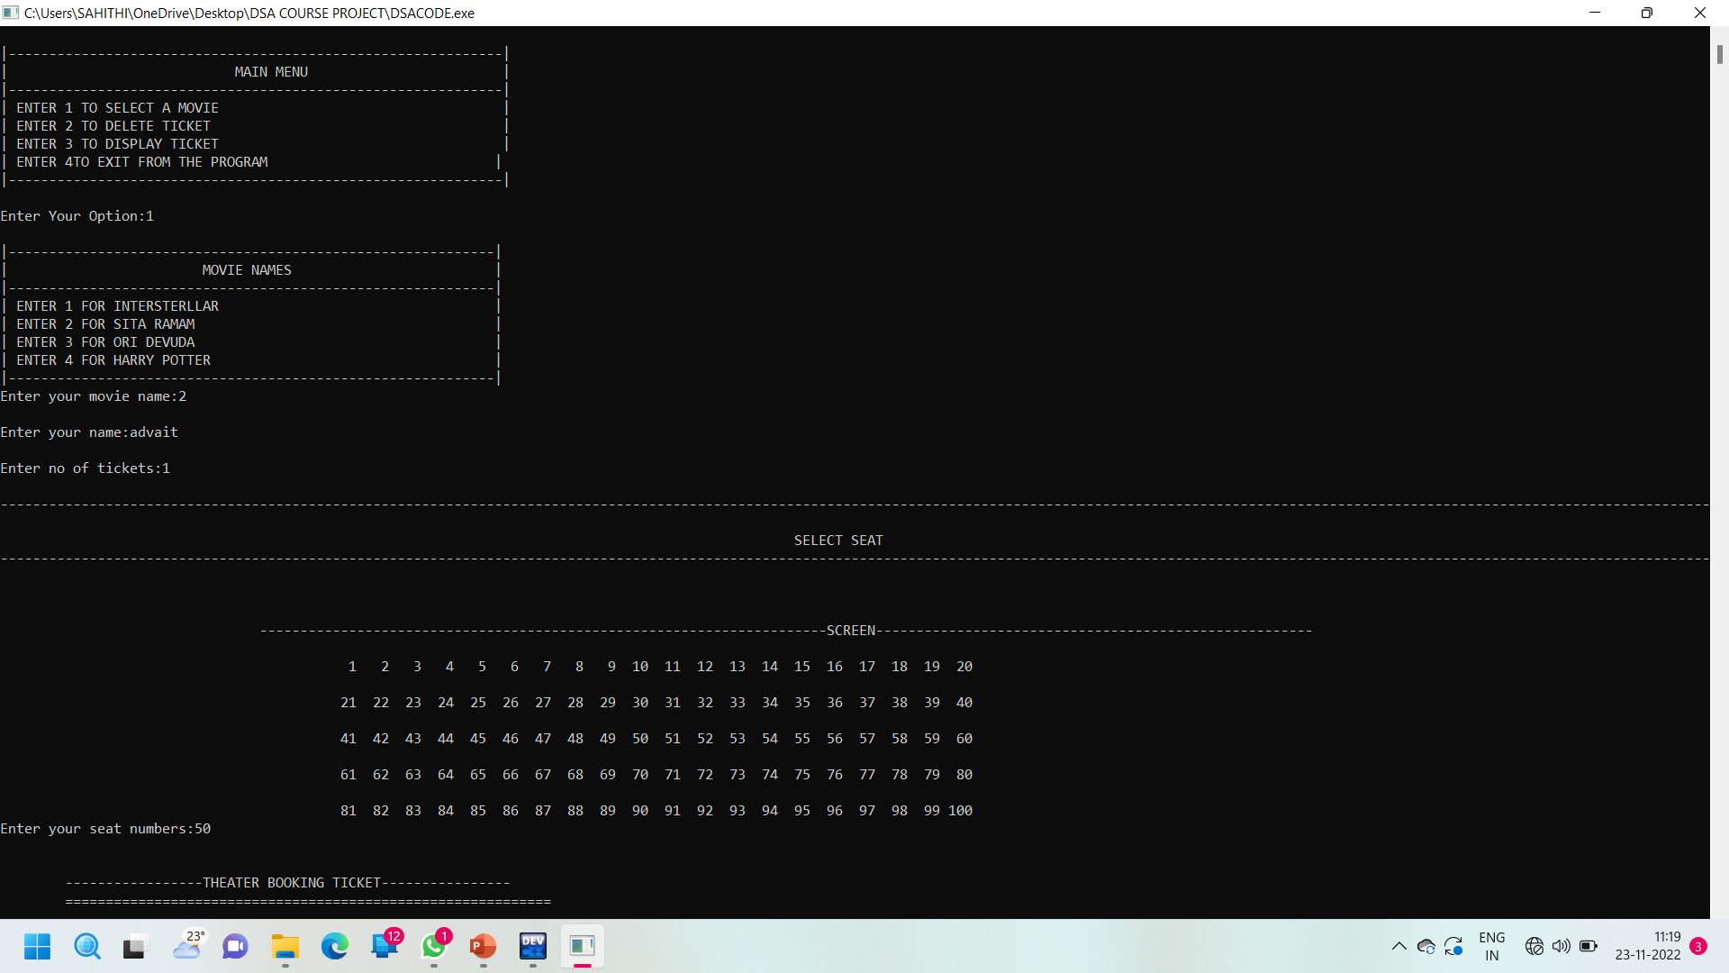
Outputs of our Project
Output for Inserting or Creating the ticket

Slide 27
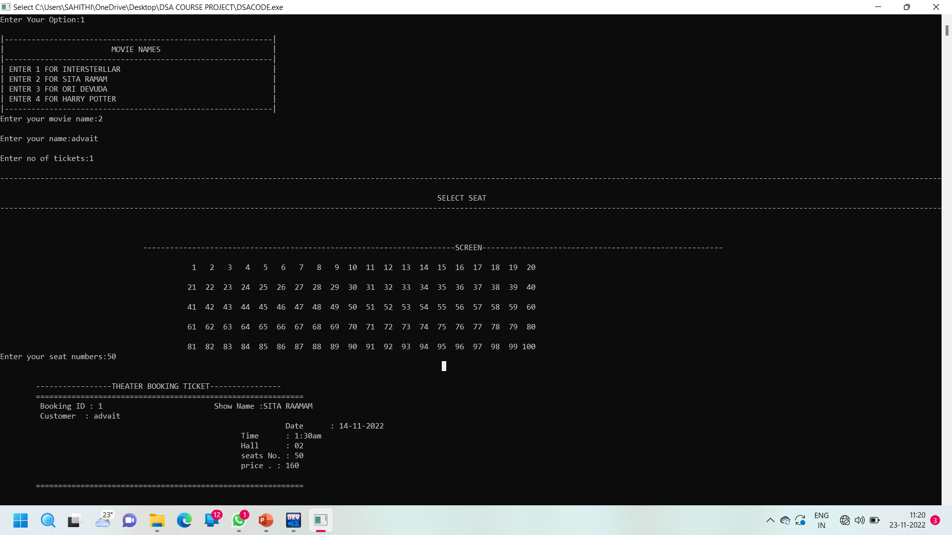

Slide 28
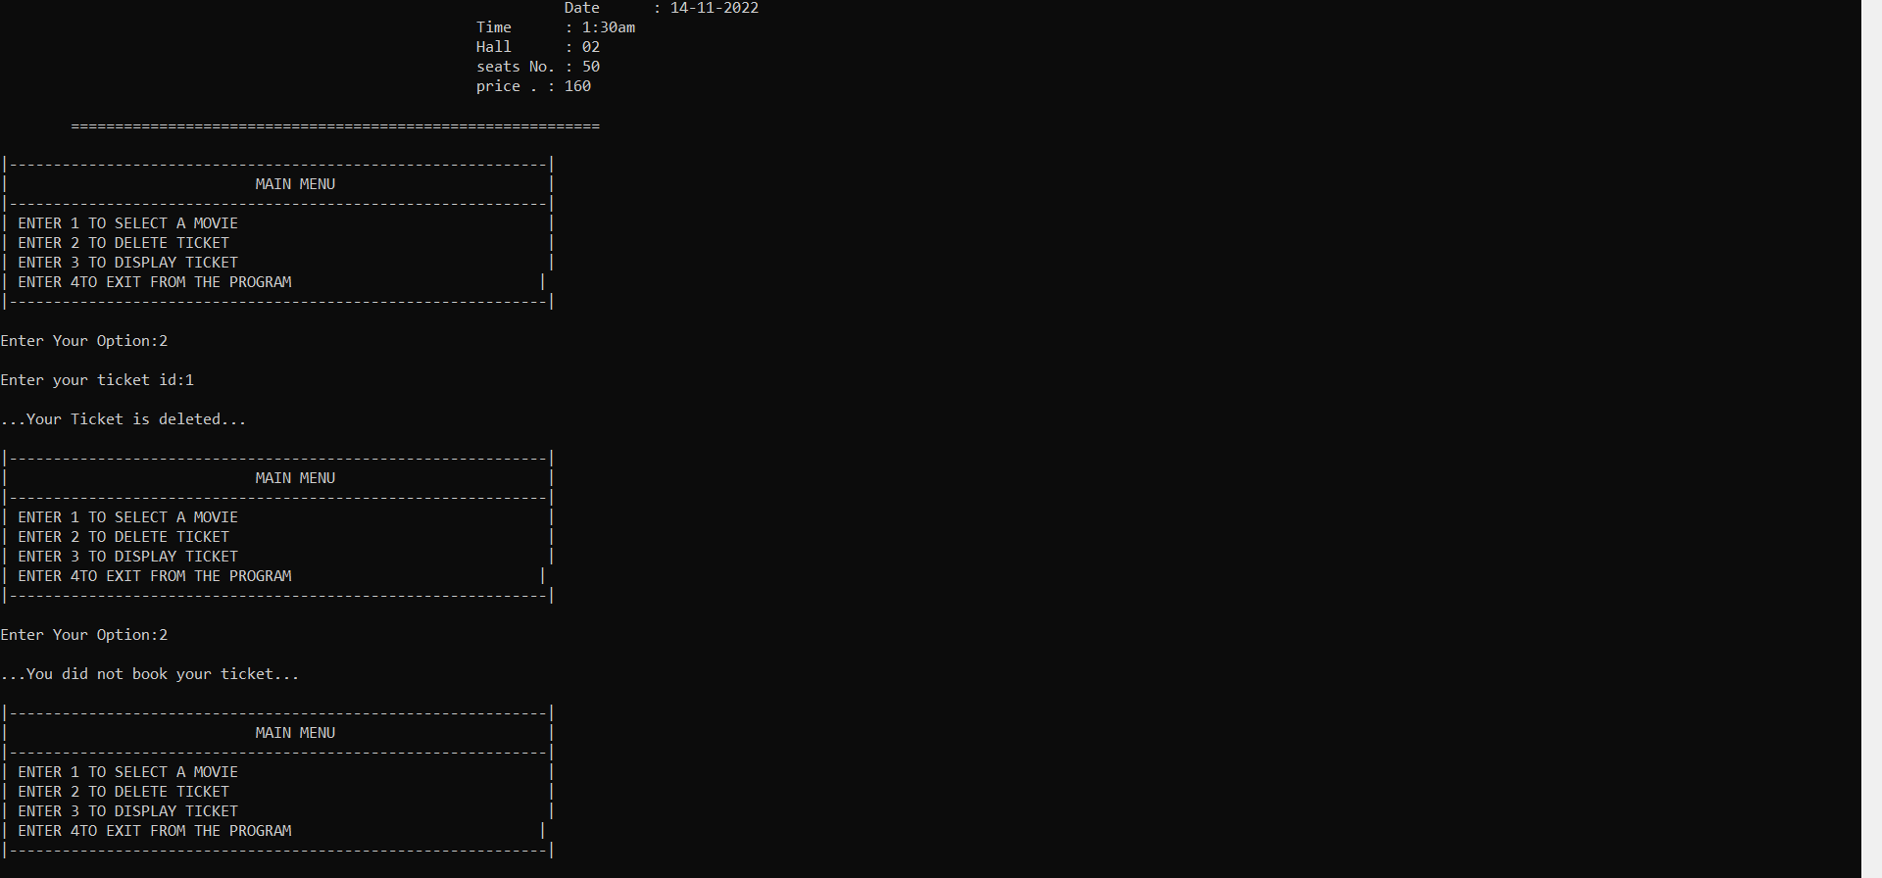
Output for Deleting the ticket

Slide 29
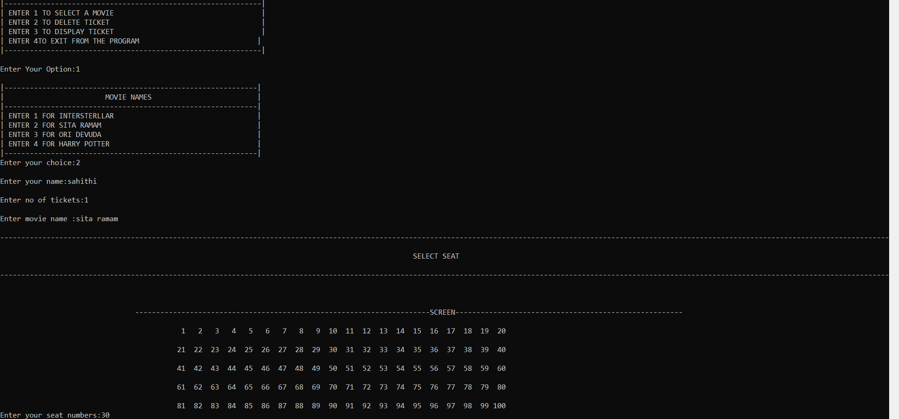
Output for Displaying the ticket and exit from the program

Slide 30
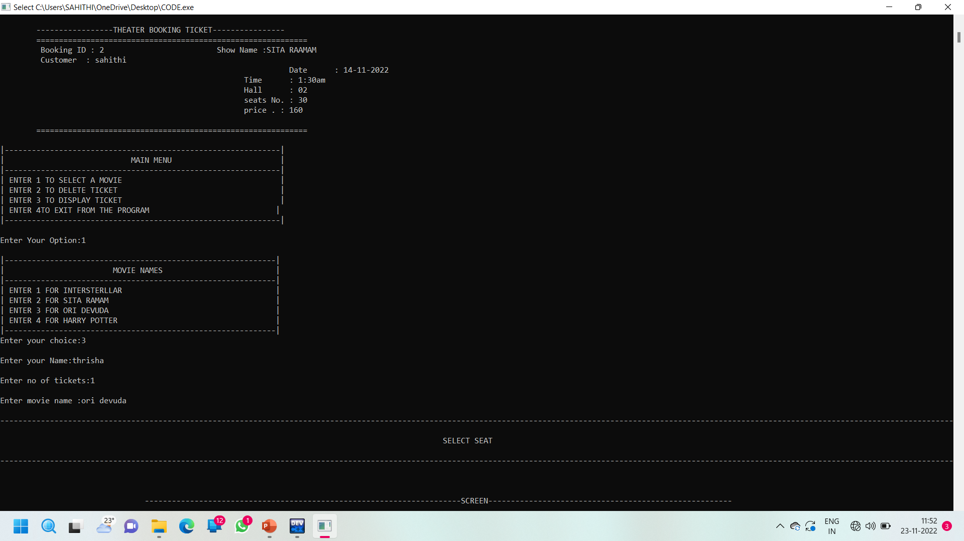
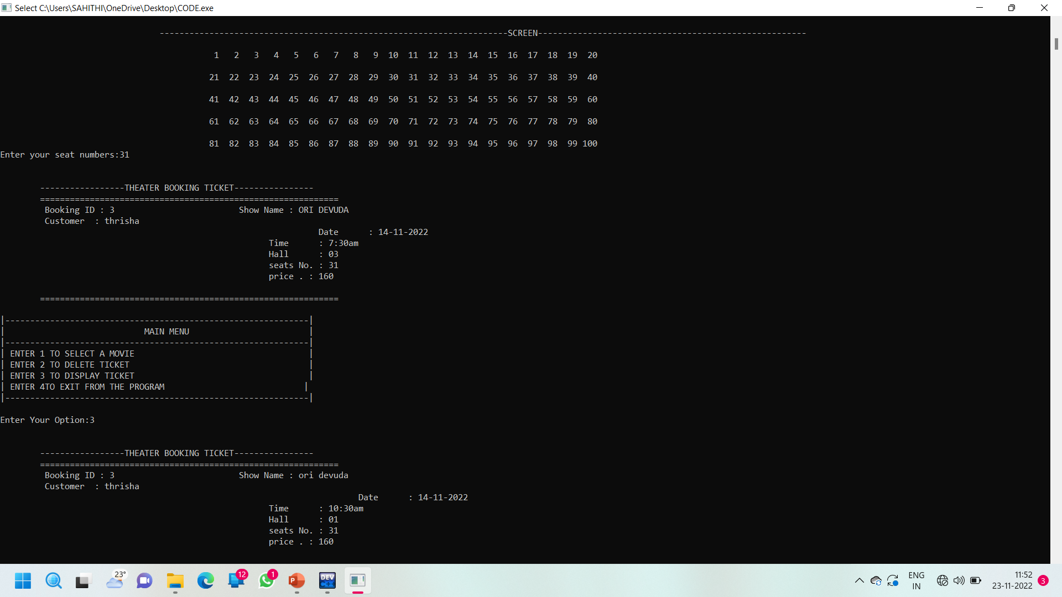

Slide 31
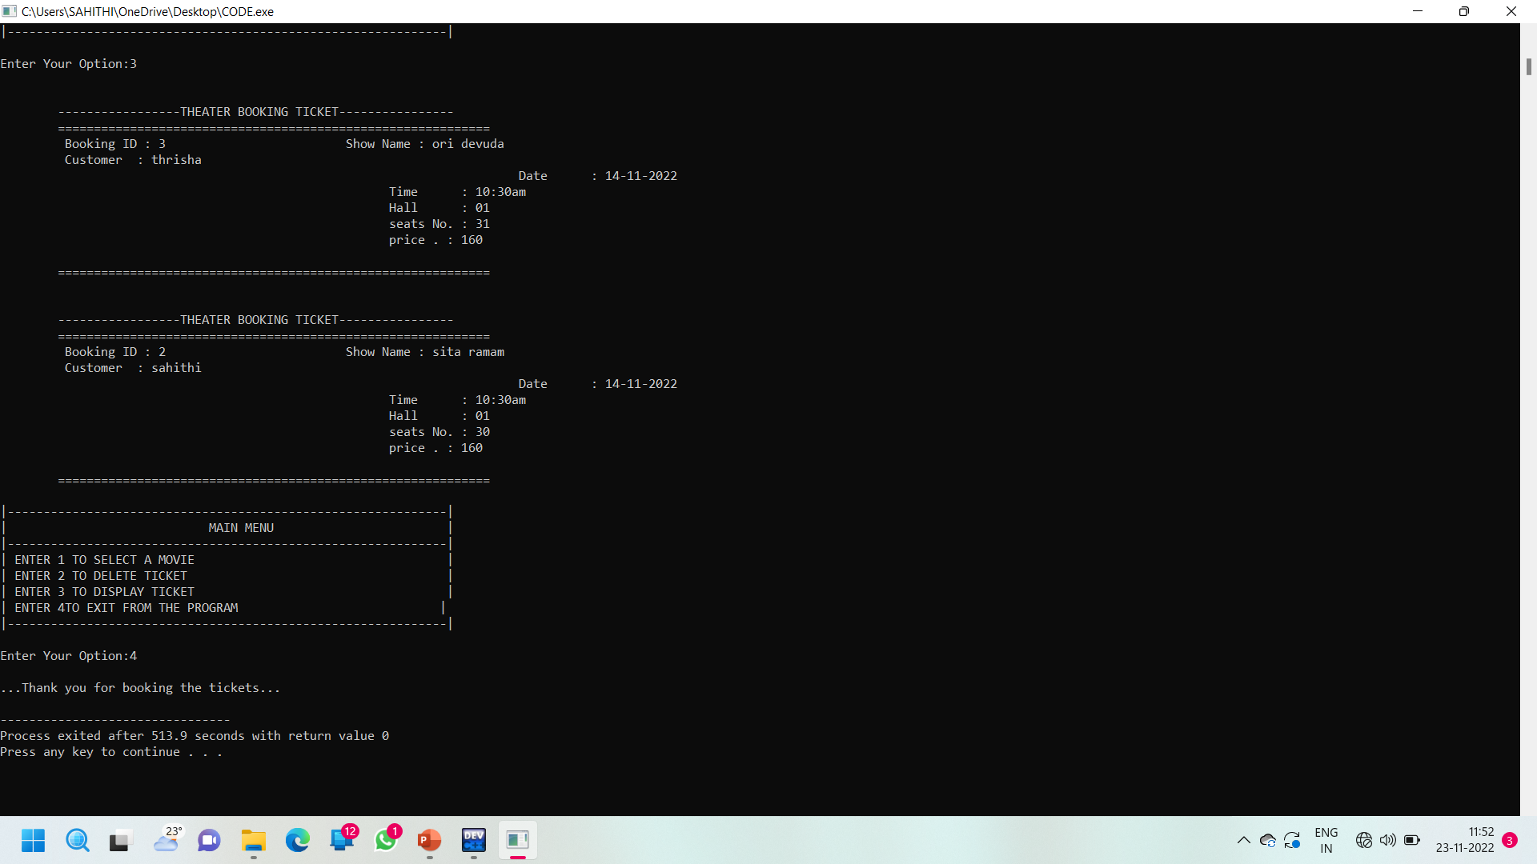

Slide 32
Conclusion
The Conclusion of our project is so by this project we book a ticket as many we want as well as we can delete the ticket and it will also display the all tickets what we have booked before.

Slide 33

THANK YOU

